Slide 1
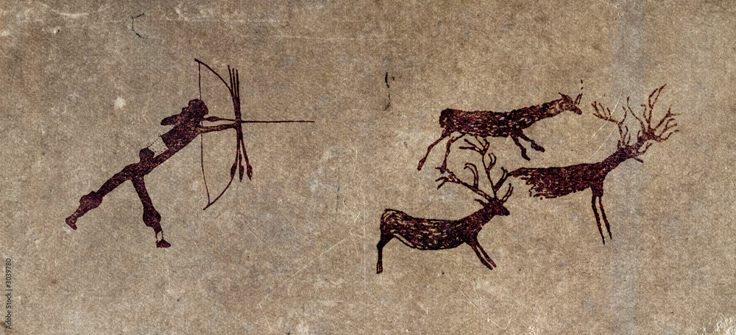
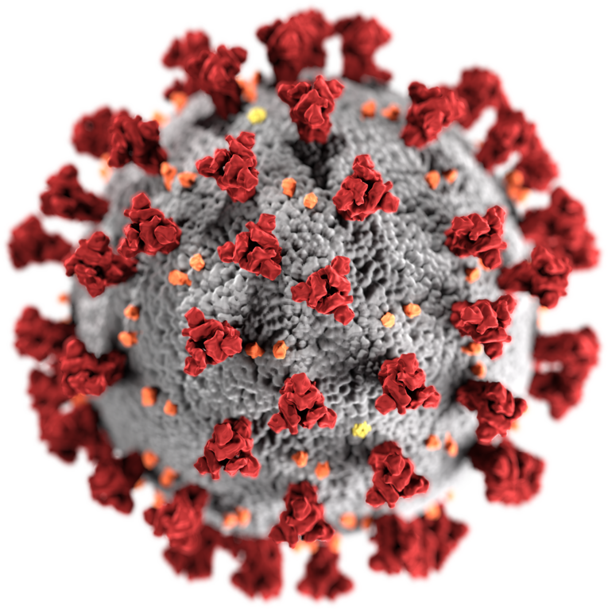
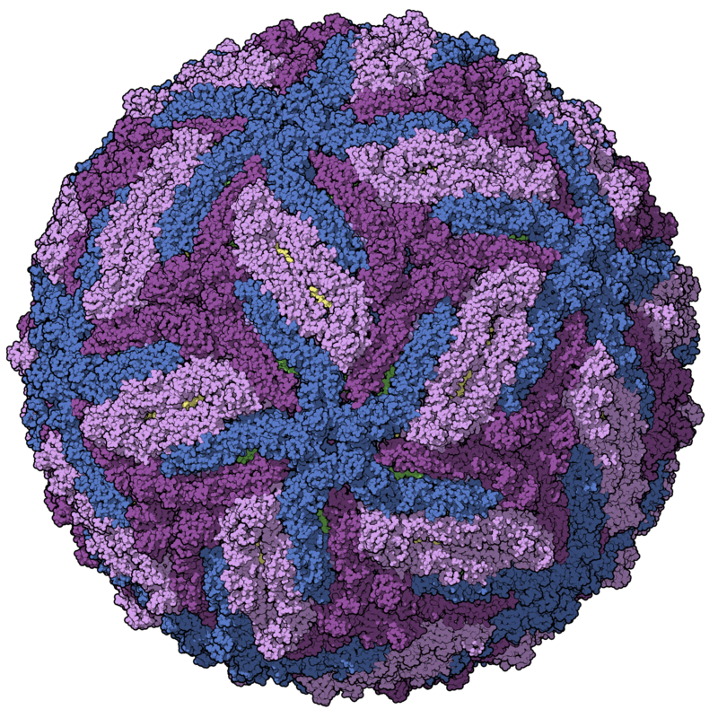
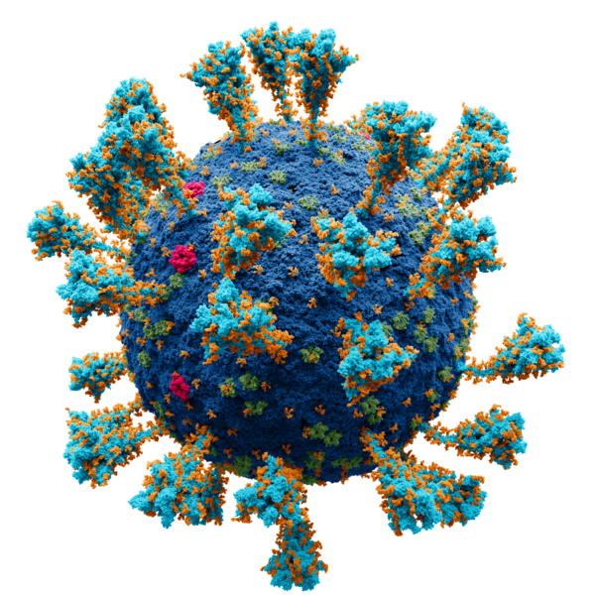
Virome characterisation from unprocessed local and publicly available sequencing data
VirushunterGatherer and Virusparies
Sergej Ruff
Twincore - RG Computational Virology
22 August 2024
Notes:
→ Good Morning
→ Today, Presenting the current progress of my master thesis, which I started almost 2 months ago.
→ Topic is the characterization of the virome after liver transplantation
→The Taubert Working Group at the MHH were so kind to provide me with liver Sequencing data
→ and I am applying VirushunterGatherer to characterize the virome of those samples and maybe find novel viruses.
→ Then I am plotting and analysing the output using a small R package I created called Virusparies.

Slide 2
Characterzation of the virome,VirusHunterGatherer and Virusparies - Outline
Introduction
Background: Importance of Viral discovery
History of viral discovery
Summary and Goals
Methods and Material used
Workflow
Hittables
Data
Results
Taubert
Assembled sequences in mammalian samples
Virusparies Package
4. Limitations, Conclusion and Outlook
Notes:
The outline of the presentation
Follows the classic Paper/ Journal Structure.
First → Talk about the motivation behind virus discovery.
Second → Then I want to talk about the history of viral discovery real quick and how it applyes to vhvg.
Method → Talk about the data and changes made to VhVg. Present the output of VhVg that I used for further analysis.
Results
Conclusion and Outlook.

Slide 3
Introduction
Why do We need virus discovery?

Slide 4
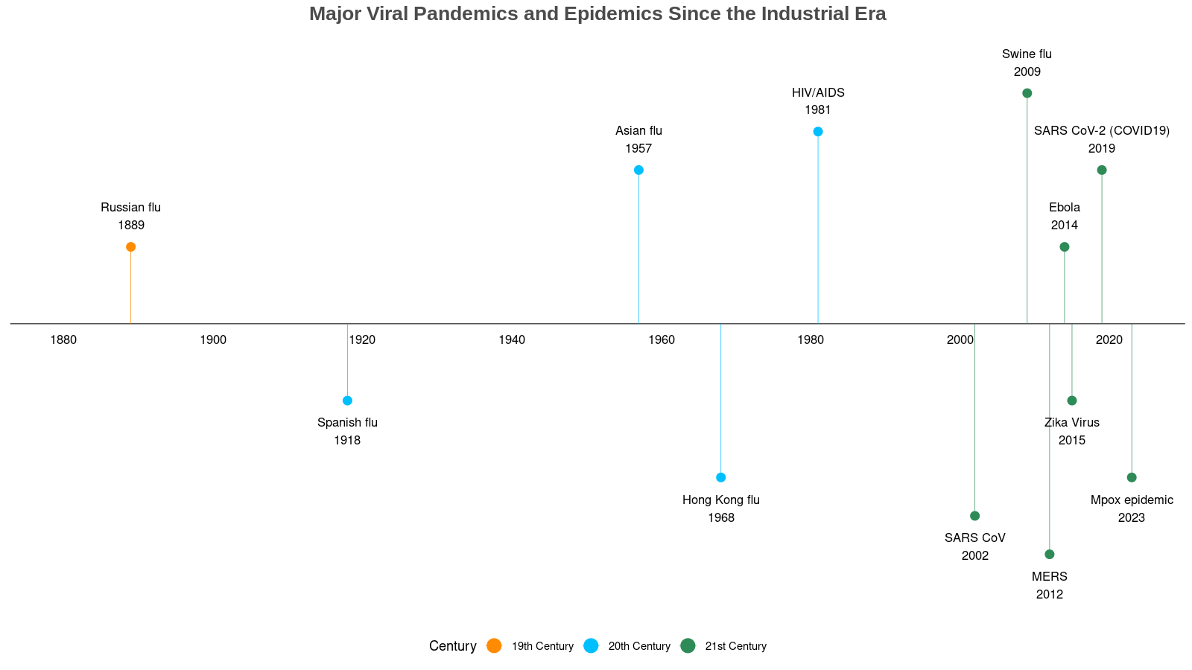
Introduction:
Importance of Viral discovery
- Pandemics
“Earlier, large-scale epidemics spanning various continents were a twice or thrice a century phenomenon, but we have experienced 6 major pandemics in the last 20 years itself.”
Bhadoria P, Gupta G, Agarwal A. Viral Pandemics in the Past Two Decades: An Overview. J Family Med Prim Care. 2021 Aug;10(8):2745-2750. doi: 10.4103/jfmpc.jfmpc_2071_20. Epub 2021 Aug 27. PMID: 34660399; PMCID: PMC8483091.

Slide 5
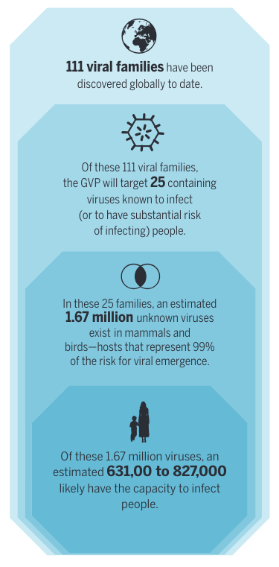
Introduction: Importance of Viral discovery
- Pandemics: number of unknown viruses
“Following each outbreak, the public health community be-moans a lack of prescience, but after decades of reacting to each event with little focus on mitigation, we remain only marginally better protected against the next epidemic. Our ability to mitigate disease emergence is undermined by our poor understanding of the diversity and ecology of viral threats, and of the drivers of their emergence.”
Carroll D, Daszak P, Wolfe ND, et al. The Global Virome Project. Science.
2018;359(6378):872-874. doi:10.1126/science.aap7463

Slide 6
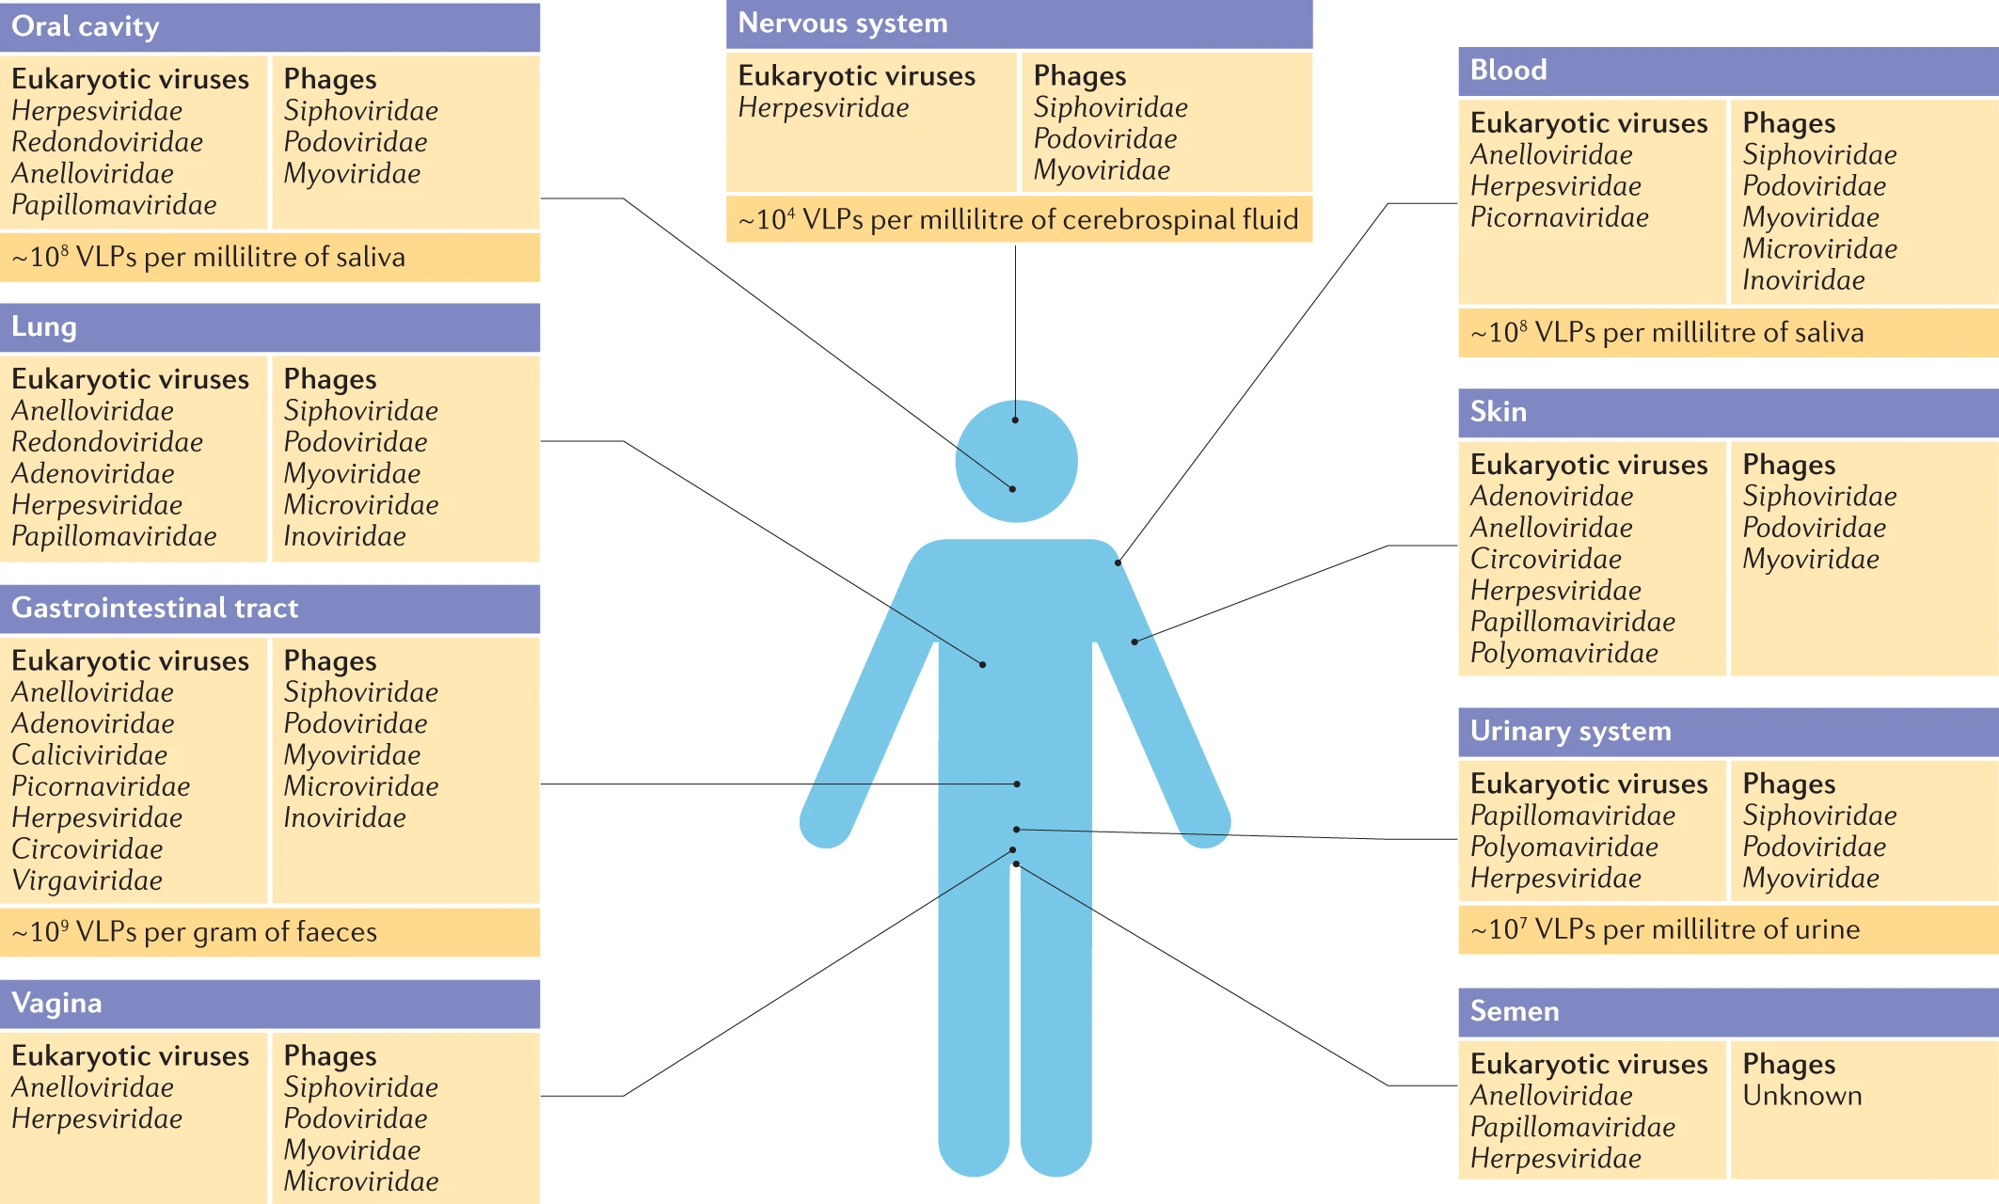
Liang, G., Bushman, F.D. The human virome: assembly, composition and host interactions. Nat Rev Microbiol 19, 514–527 (2021). https://doi.org/10.1038/s41579-021-00536-5
Introduction: Importance of Viral discovery - Virome
approximately 10¹³ particles per human individual.
High heterogeneity across different body sites
Infecting our cells and cellular microorganisms.
“ Despite increasing focus, it remains the case that the majority of sequence data in a typical virome study remain unidentified, highlighting the extent of unexplored viral ‘dark matter’.”

Slide 7


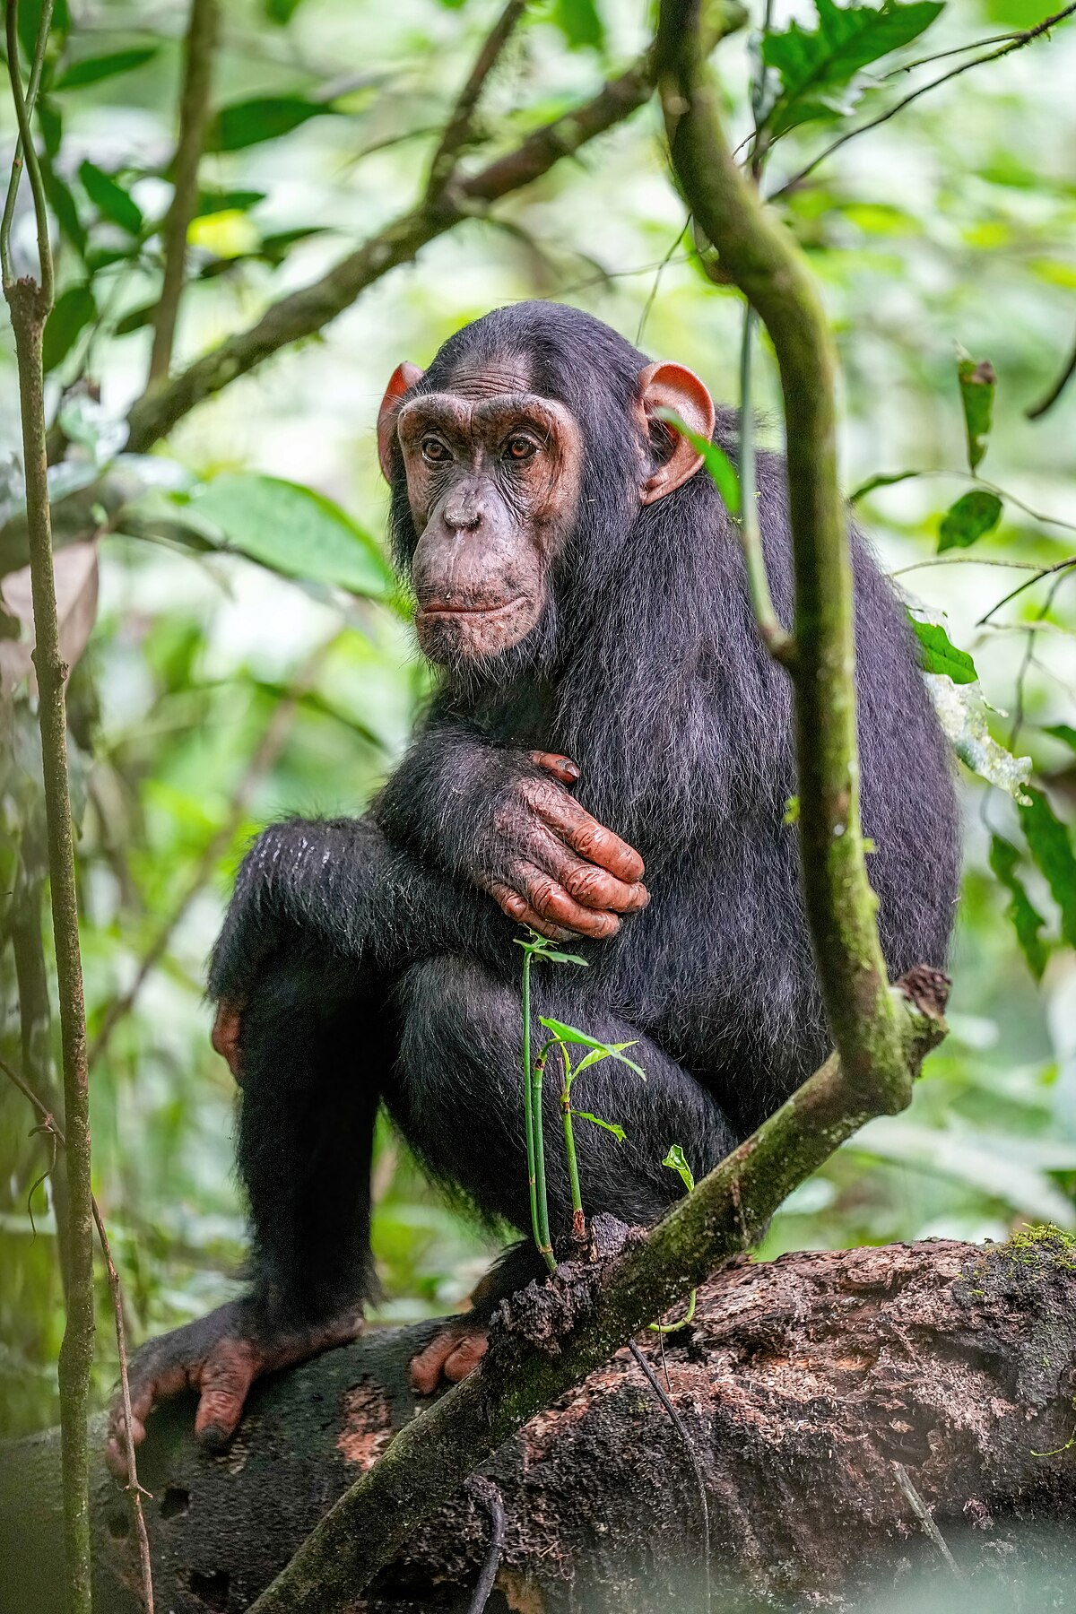
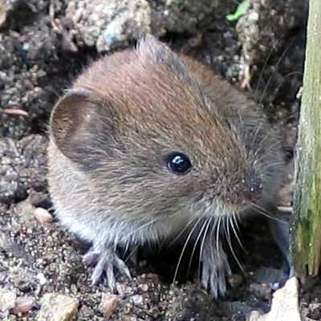
Introduction: Importance of Viral discovery – surrogate viruses and viral history
Endangered!
Approximately 50 million people are living with HCV infection (Global hepatitis report 2024: action for access in low- and middle-incomecountries.).
Liver fibrosis: abnormal buildup of extracellular matrix proteins in the liver, often leading to liver failure and cirrhosis. Hepatocellular carcinoma (HCC) → liver cancer.
Treatment: direct-acting antiviral (DAAs) regimens.
Surrogate
GBV-B
?

Slide 8
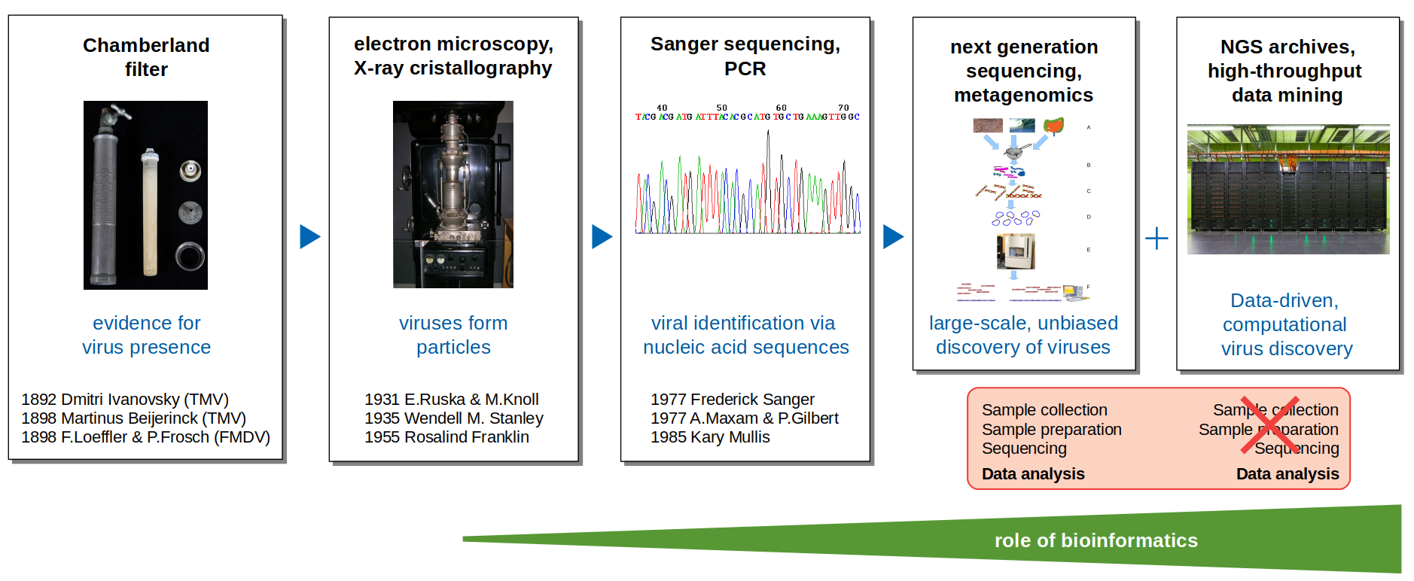
Introduction: History of viral discovery
Image taken from Prof. Dr. Chris Lauber.

Slide 9
Introduction: Summary and Goals
Importance of viral discovery
Identification of (Novel) Viruses During Outbreaks.
Better Understanding of the Virome.
Exploring Novel Model Organisms for Studying Human Viral Infections.
New data-driven viral discovery is complementary to wet lab experiments, utilizing publicly available data.
Goals:
Utilize VirusHunterGatherer on the liver sequencing data (Taubert) to characterize the virome and assess whether these identified viruses are associated with transplant rejection.
Assemble potential viral sequences found in mammalian samples.
Virusparies.

Slide 10
Methods and Material used

Slide 11
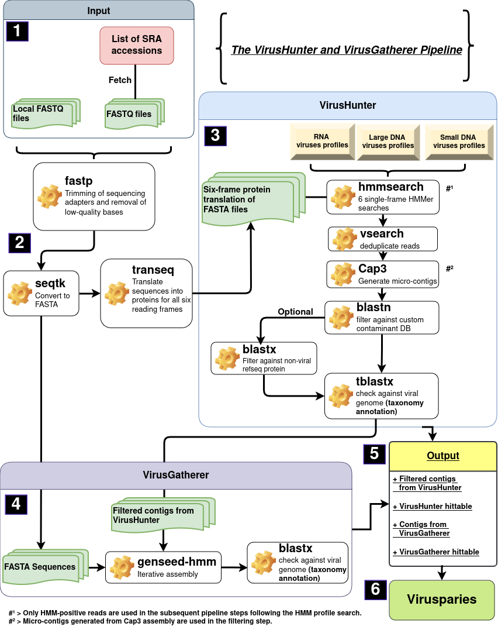



Schematic workflow of
VirusHunterGatherer pipeline
Taubert liver sequencing data
Mammalian sequencing data
SRA
Notes:
Reminder: Use VhVg
> Perform Data driven viral discovery by running our unprocessed data against profiles in an Hidden Markov model
> Filter against contaminants and viral data base
> Use found contigs as seeds for progressive assembly of viral contigs in gatherer
>perform taxonomic annotation with blast
> generate hittable for 3 data sets. Only 2 used for master thesis

Slide 12
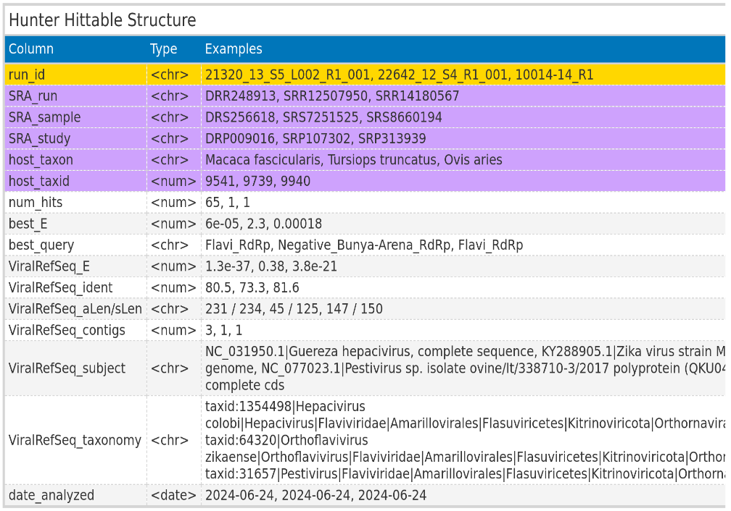
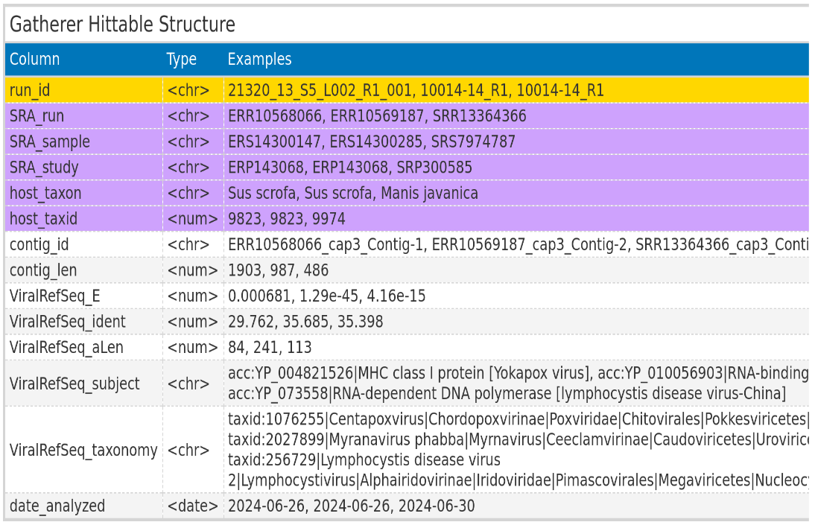
VirusHunterGatherer hittables
ViralRefSeq_taxonomy processed to extract virus family
Notes:
The VhVg output I use for downstream analysis: Hittables
> Save the best results for the search against profiles and the search against the viral database.
> Some columns are exclusive to local files, some are for fetched files.
> Processed taxonomy
> Next I want to describe the data is used.

Slide 13
Taubert data
Local files from AG Taubert
Samples: Liver
All 3 Virus groups
Notes:
> Start with taubert
> Taubert working group at mhh
> Focus on immune response of liver before and after transplantation.
> Kind enough to provide patient liver data
> I searched all 3 viral groups

Slide 14
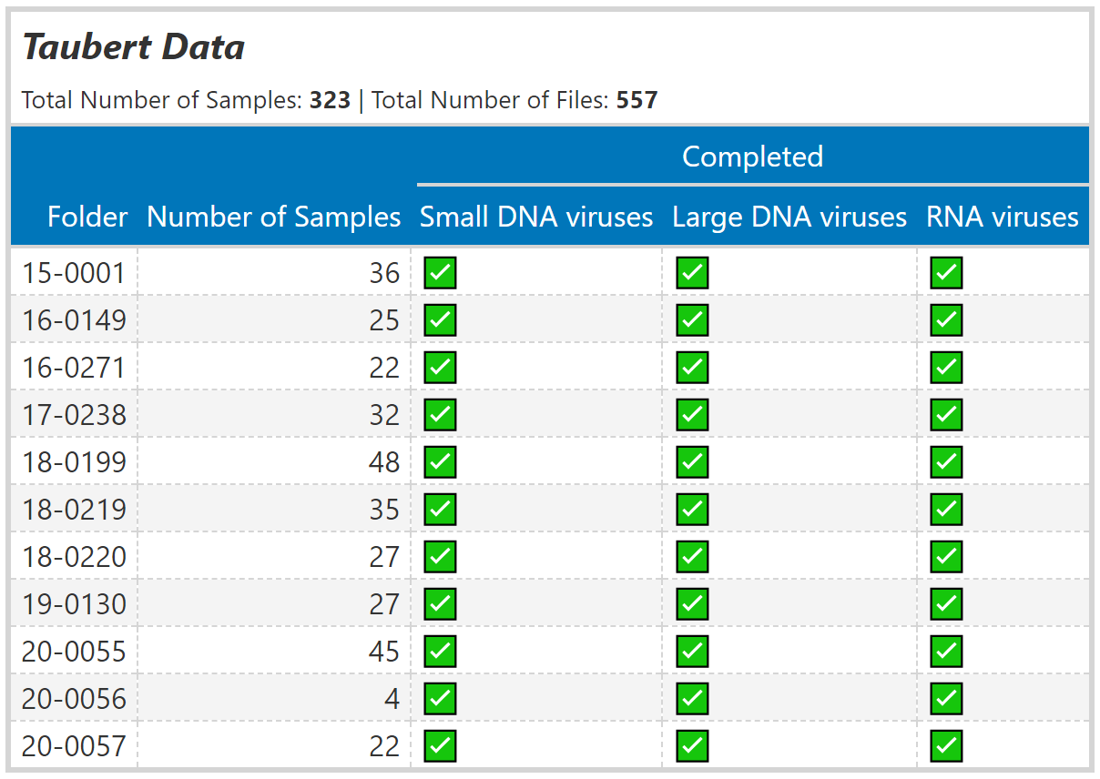
Taubert data – liver sequencing data
Notes:
> Folder structure
> Paired end reads seperated into files → more files than samples. 323 samples but 557 files

Slide 15
Mammal data
SRA IDs re-examined from existing Hittable
RNA viruses only
Notes:
Next → Chris provided me with existing hittable.
→ Consisting of Mammalian data
> I subset the hittable for specific criteria and analyzed the subset again.
> The hittable contained RNA viruses for mammals. Therefore I only ran the RNA virus group for VHVG.

Slide 16
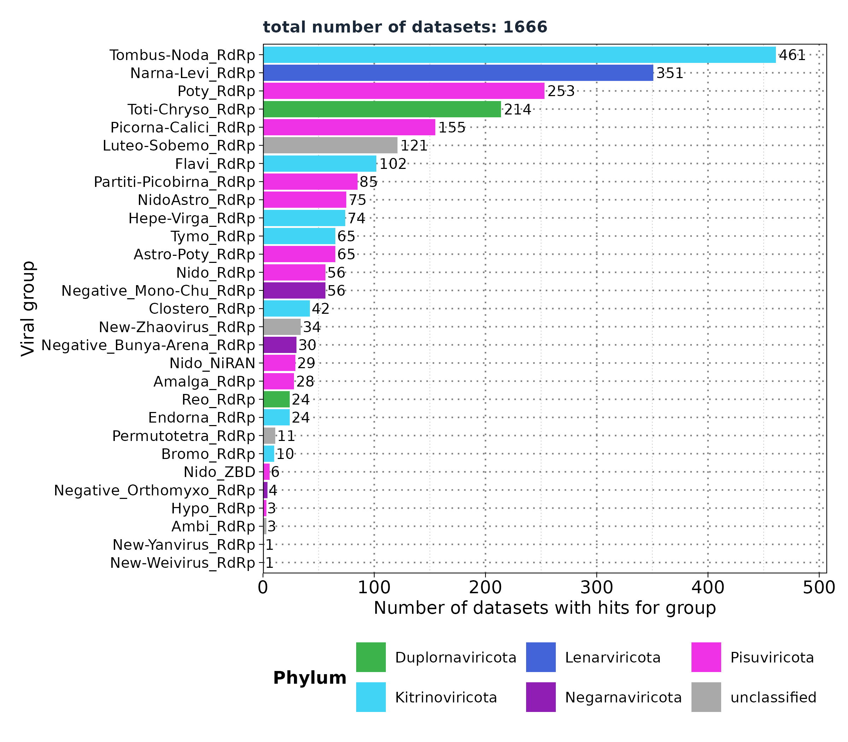
VirusHunter - Screening for RNA viruses in mammalian SRA data
Selected profiles:
Flavi_RdRp
Hepe-Virga_RdRp
Nido_RdRp
Negative_Bunya-Arena_RdRp
Negative_Mono-Chu_RdRp
Negative_Orthomyxo_RdRp
Nido_NiRAN
NidoAstro_RdRp
Existing Hittable:
34.337 unique SRA Ids
Filtered based on:
'num_hits' > 4
'ViralRefSeq_E' < 1e-5
'ViralRefSeq_ident' < 90
Notes:
> Almost 100000 observatiosn with 34.000 samples.
> Criteria filtered : contig length criteria to make sure, something gets assembled by gatherer, only significant groups and we concentrate on novel viruses.
→ 1666 SRA ids left
> Still too much. Further filtering for specific groups
> Analyzed 6/8 groups

Slide 17
Results: Taubert
Notes:
Lets talk results. Starting with taubert

Slide 18
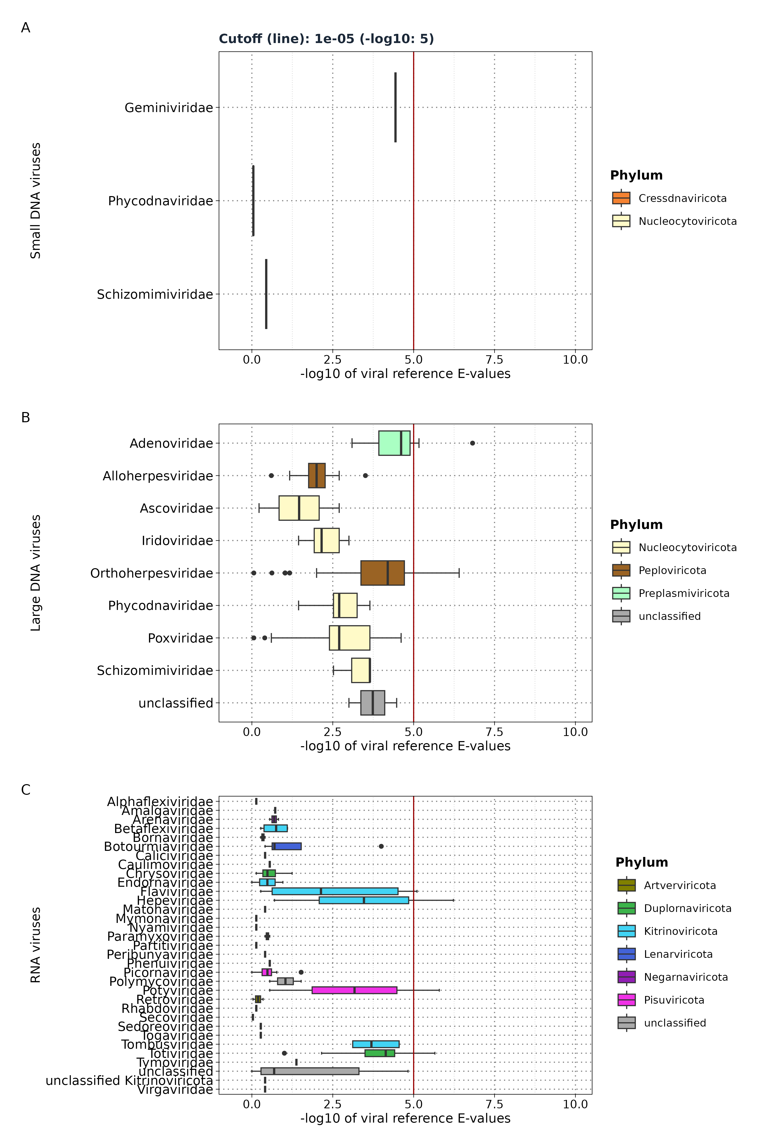
Results: Taubert - Distribution of viral reference
E-values
Liver sequencing data: 557 FASTQ files
VirusHunter
ViralRefSeq_E < 1e⁻⁵
Screening for ...
Small DNA Viruses
Files: 5 (0.89%)
Samples: 4
Families: 3 (0)
Large DNA Viruses
Files: 165 (29.62%)
Samples: 142
Families: 8 (2)
RNA Viruses
Files: 17 (3.05%)
Samples: 13
Families: 31 (4)
Notes:
> Here you see the E-value distribution for all 3 families.
> The red line shows a cut of 10 to the power of -5.
> We use the log10 of evalues
> Sort by median.
> Everything below that is not significant and wont be shown on the next plots.
> 1. You can see not a lot was found for 557 files
> 2. All the observations are close to the cutoffline.
> 3. See uroviricota which are usually dsDNA phages among RNA viruses.

Slide 19
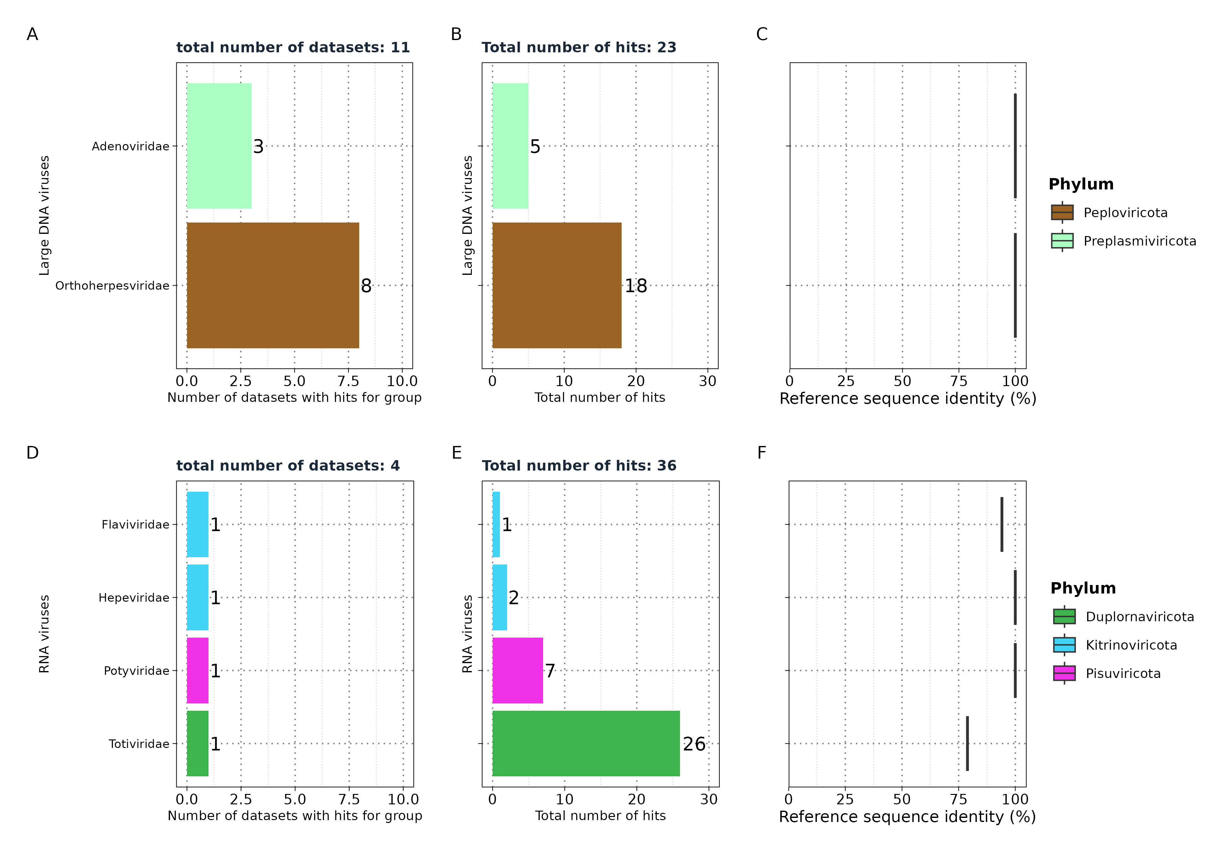
Results: Taubert
Significant hits in
VirusHunter
Notes:
Viral Group entferen in dem B plot bei allen Datensätzen

Slide 20
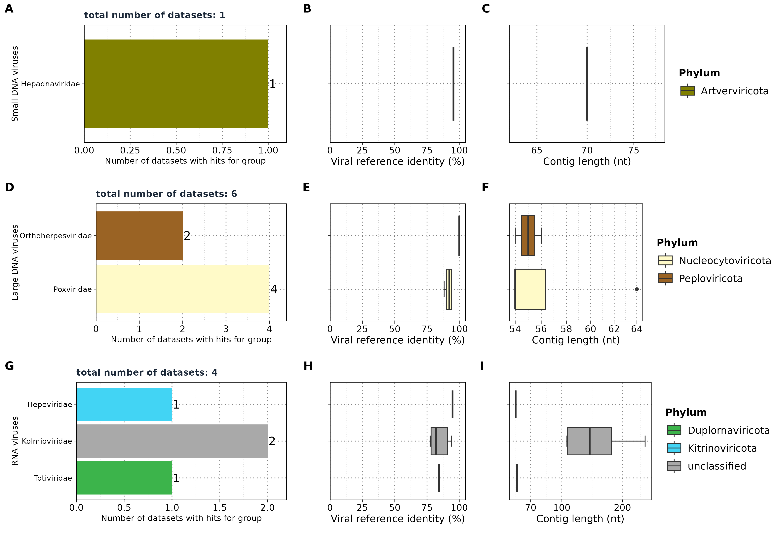
Results: Taubert
VirusGatherer
Liver sequencing data: 557 FASTQ files
VirusHunter
VirusGatherer
Notes:
From here on out all plots which dont plot the e-value will be filtered for 10⁻5. Thats why you see fewer results. The same applyes for teh other data sets.
Only signficant groups are shown here.

Slide 21
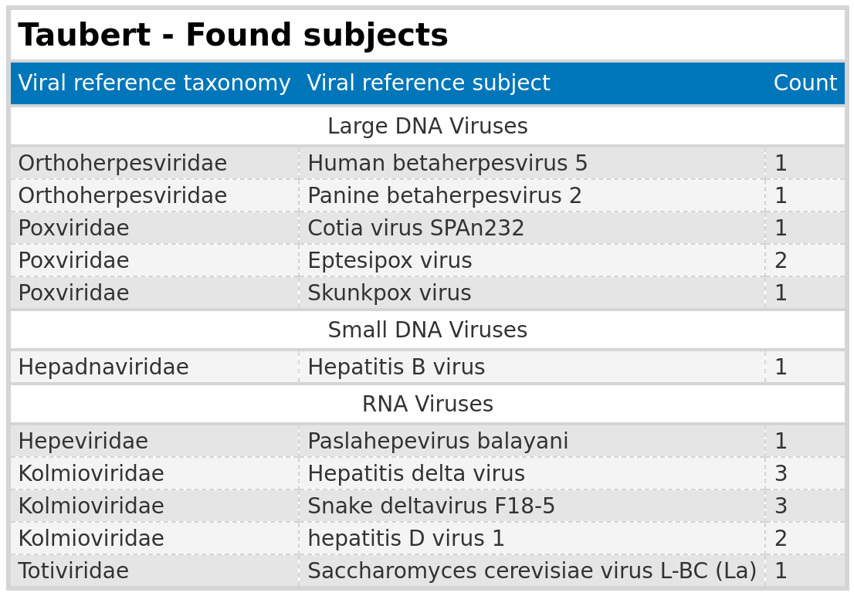
Results: Taubert
Subjects
Notes:
The contig lengths are really short
Evalues are so low they are almost not significant,
But I extracted the subject reference virus to see what the contigs mapped to.
> We see totivirae maps against a yeast virus
> We have a snake deltavirus
> Poxviruses you find in bonobos,skunks and mice from brazil
> So most likely false positives.

Slide 22
Results: Taubert
Summary
Analysis Summary: Completed analysis of Taubert data for small DNA, large DNA, and RNA viruses
Data Overview: Out of 557 FASTQ files, only a maximum of 6 files returned assembled contigs
Significance Threshold: Significant results were close to the E-value cutoff of 1e-5
Contig Lengths: Identified contigs were all below 300 nt
No conclusive evidence links viral infections to liver rejection.

Slide 23
Results: Mammal
Notes:
Next the results for the mammalian data

Slide 24
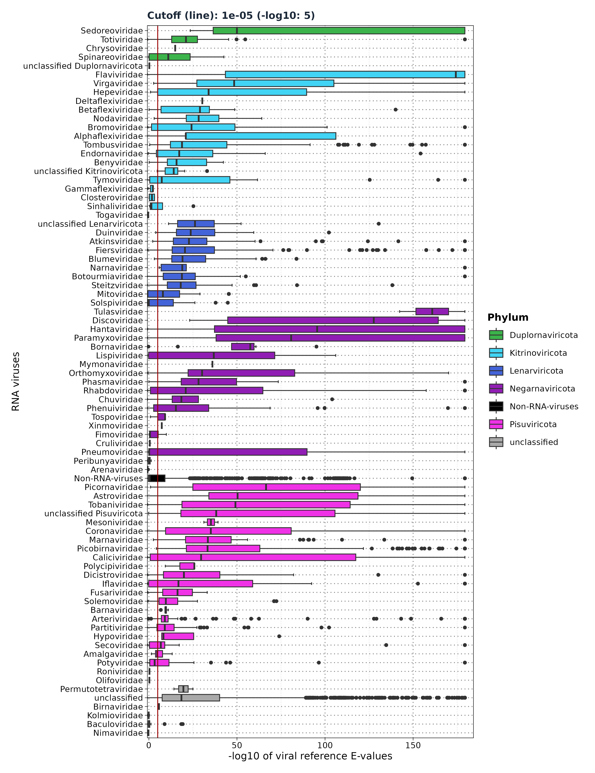
Results: Mammal – Distribution of viral
reference E-values
VirusHunter
19,113 micro-contigs
VirusGatherer
ViralRefSeq_E < 1e⁻⁵
Assembly returned ...
Total Contigs Assembled: 8,232
Aligned to Viral Families: 128 families + 6 unclassified
High-confidence Alignments: 6,209 contigs with E-values < 1e⁻⁵
Contigs by Phylum
Pisuviricota: 2,553 contigs (2,212 aligned; 86.64%)
Lenarviricota: 773 contigs (686 aligned; 88.75%)
Kitrinoviricota: 552 contigs (453 aligned; 86.78%)
Negarnaviricota: 281 contigs (209 aligned; 74.37%)
Duplornaviricota: 124 contigs (115 aligned; 92.74%)
Notes:
Here we see the E-values.
> I combined all 6 groups into one after running vhvg seperatly for each group.
> We use the same cutoff
> Flaviviridae has the highest median with extremly low E-values for 50 % of the data.
> Followed by Astroviridae.
> The median difference between first place and second place is large.
> 3 dominant phyla: Pisu, lena and kitrinoviricota
> We have values below the threshold such as baculoviridae with only 2 outliers being above.

Slide 25
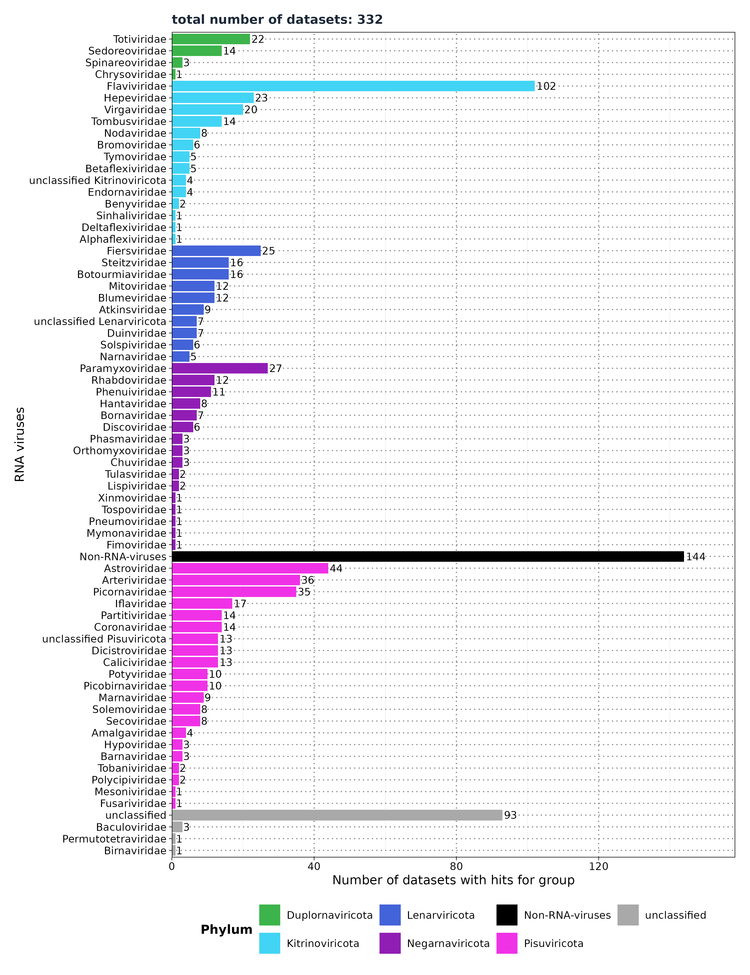
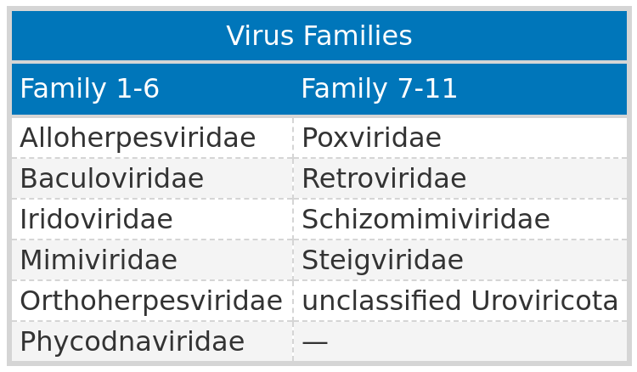
Results: Mammal - Number of datasets with
viral hits
VirusGatherer
Filter ViralRefSeq_E < 1e⁻⁵
Viral Reference E-values
Non-RNA viruses: 0.37 (IQR: 7.41e⁻¹⁰ to 1.99)
RNA viruses: 1.34e⁻¹⁵ (IQR: 9.74e⁻³⁹ to 2.85e⁻⁷)
Notes:
> Here again I show only the significant results above the cutoff
> We see that 274 unique datasets exist
> Just like uroviricota in Taubert dataset we have non-rna viruses in this dataset.
> I clustred them into 1 group and found 25 non-rna virus families you see in the table.
> followed by ….

Slide 26
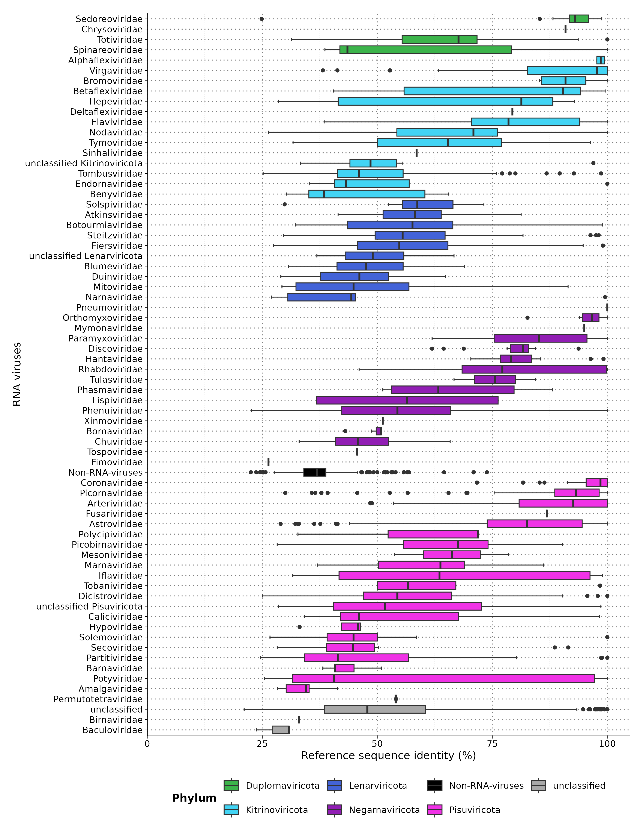
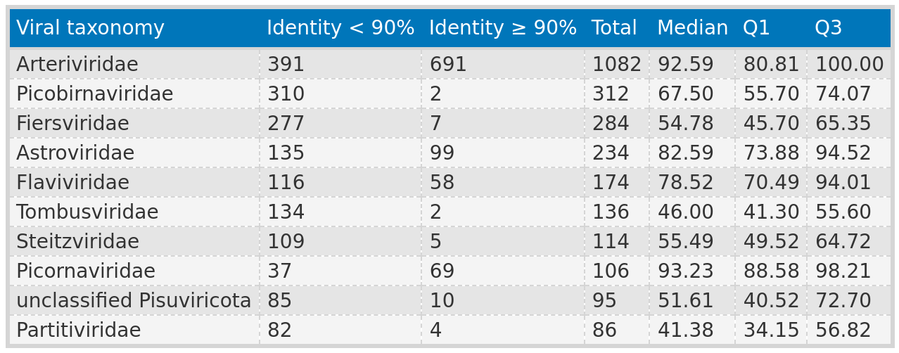
Results: Mammal - Sequence identity
80.59% of viral contigs (5,004/6,209) had <90% protein sequence identity with the closest known virus.
Notes:
Here we see the % identity against the viral Refrence
> Coronavirus have high identity % to the refrence and are most likely not novel viruses.
> On the other side.We see that flaviviridae has a median of 78 %

Slide 27
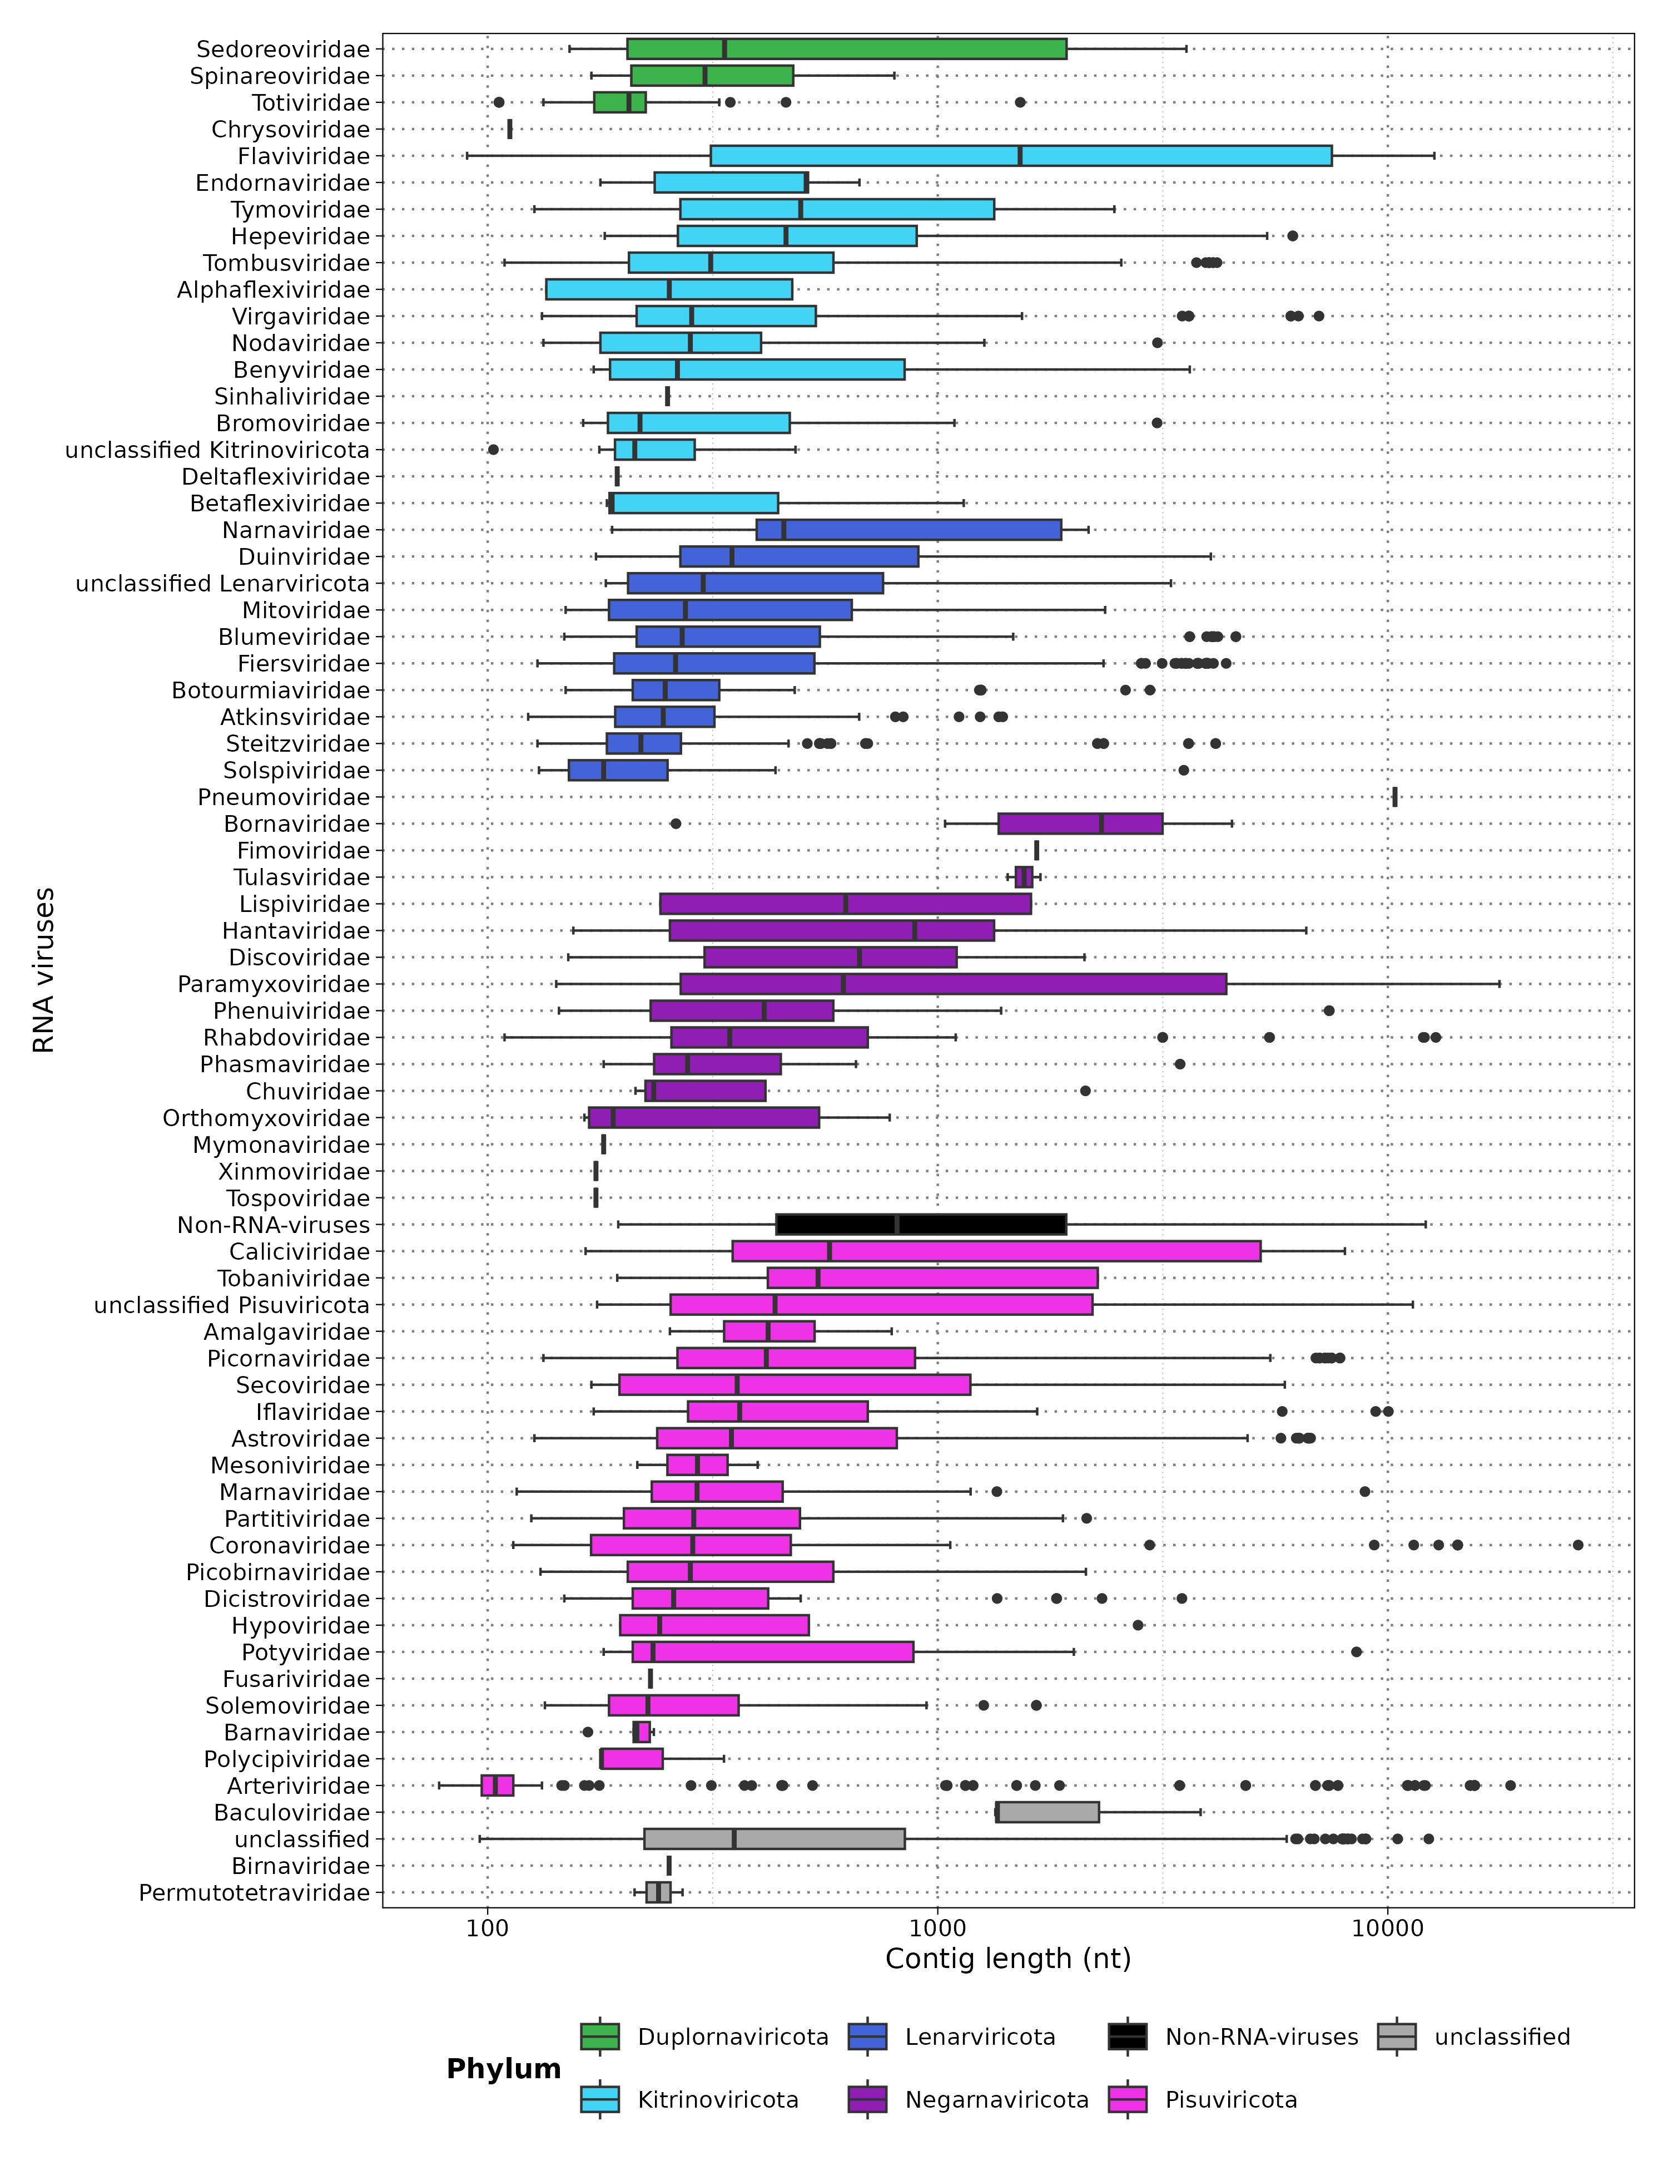
Results: Mammal - Contig Length
Overall: 19.72% (1,225) contigs >1,000 nt across all phyla.
Pisuviricota: 258 contigs >1,000 nt , 202 with <90% identity; main families: Picobirnaviridae (46), Arteriviridae (36), Astroviridae (31).
Kitrinoviricota: 148 contigs >1,000 nt , 103 novel;
main families: Flaviviridae (58), Tombusviridae (28), Hepeviridae (5).
Lenarviricota: 97 contigs >1,000 nt, 95 novel;
main families: Fiersviridae (41), Blumeviridae (14), Duinviridae (11).
Negarnaviricota: 54 contigs, 42 novel; main families: Paramyxoviridae (12), Bornaviridae (6), Hantaviridae (5).
Duplornaviricota: 10 contigs, 2 novel;
main families: Sedoreoviridae, Totiviridae.
Novel contigs >1,000 nt: 444 contigs, median length 2,619 nt (range: 1,001–26,479 nt).
Notes:
Here you see the contig length on a log 10 scale.
> baculoviridae → only 2 data points
> Flaviviridae → whole spectrum. 90 -13.000 with a median of 1500
> Picobirnaviridae in the middle with 130 -2000
> Asterviridae is last, where majority are short contigs with outliers being huge.
> Next I wanted to see what the noverl viruses are and which subjects they find.

Slide 28
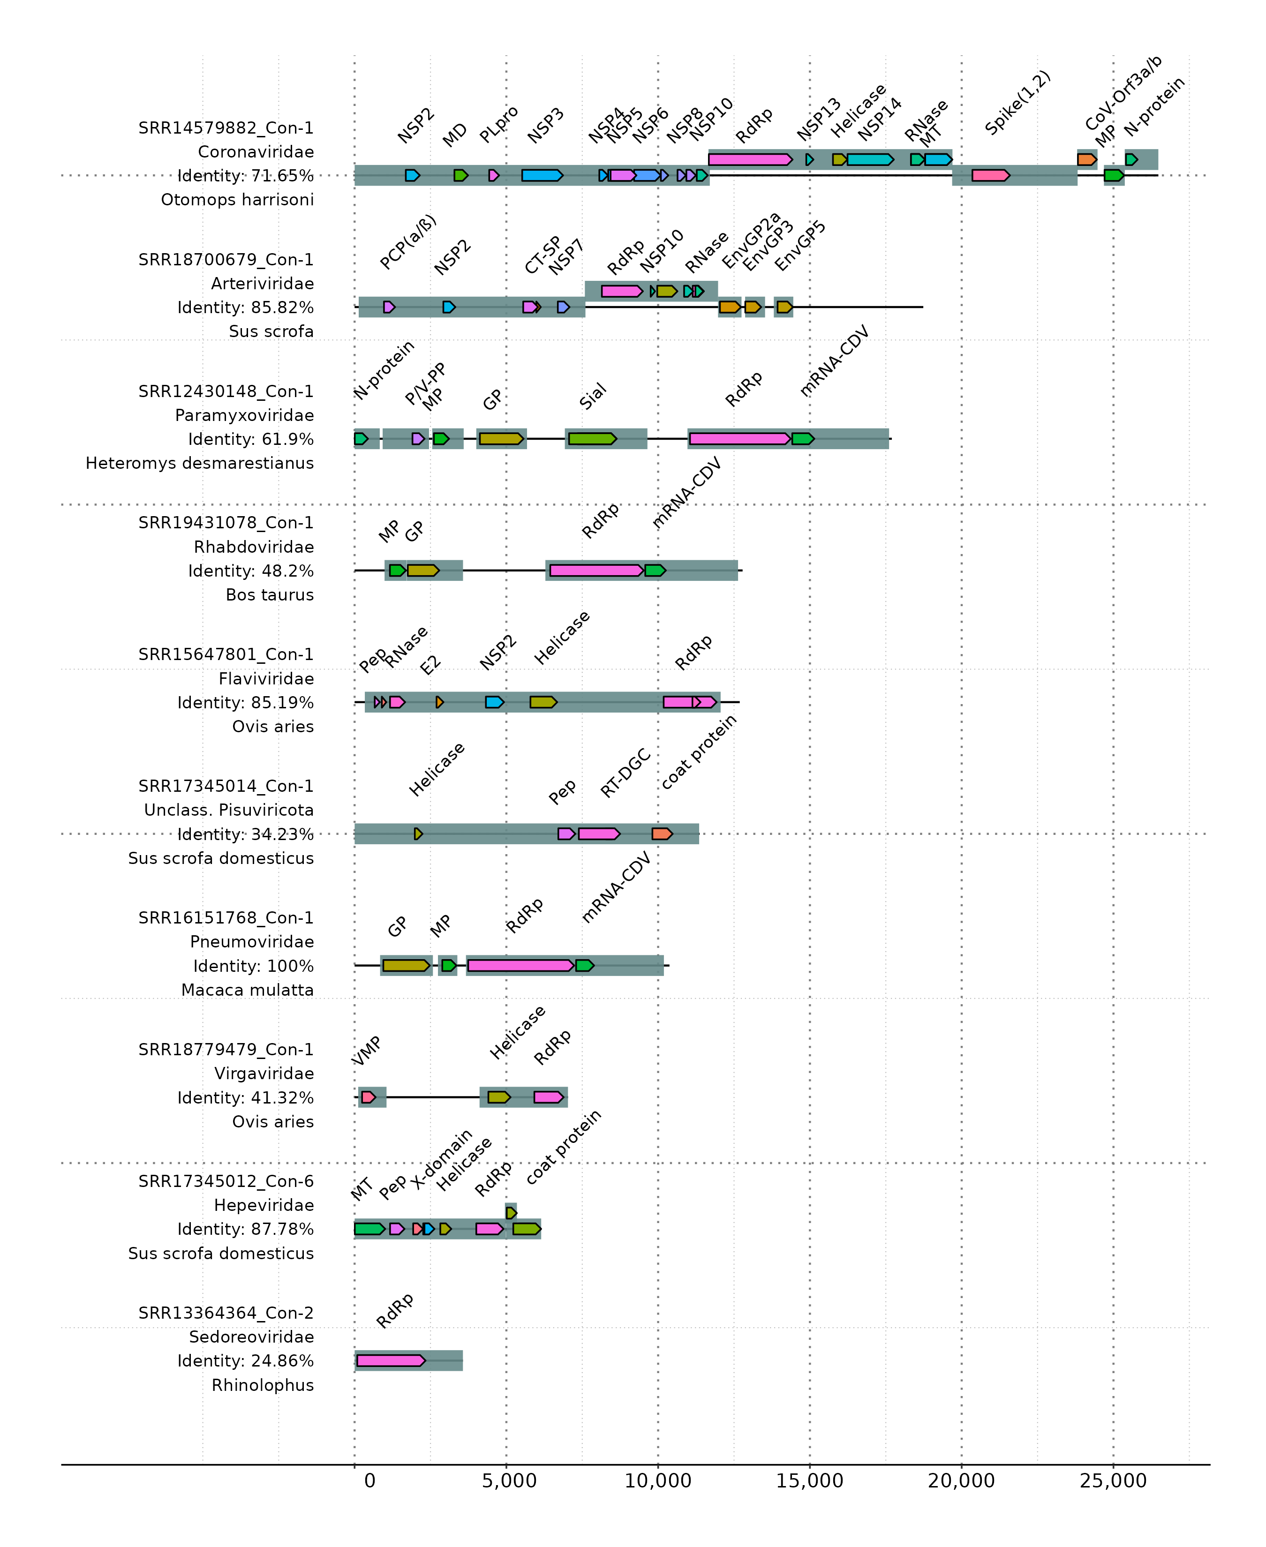
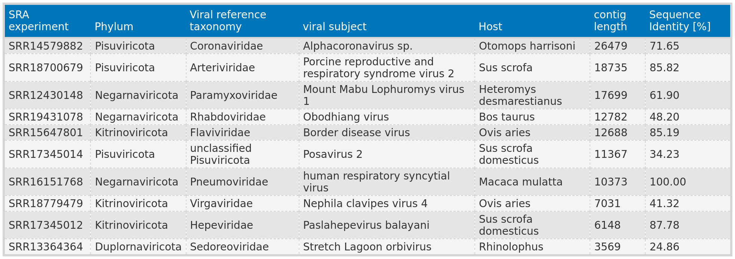
Results: Mammal - Functional annotation
of the top ten largest contigs
SRR12430148_con-1: Identified RNA editing site (TTAAAAAAGGCA), similar to Mount Mabu Lophuromys virus 1¹.
Matches conserved motif (YTAAAARRGGCA) found in Henipavirus, Morbillivirus, and Jeilongvirus genera.
¹Vanmechelen B, Bletsa M, Laenen L, et al. Discovery and genome characterization of three new Jeilongviruses, a lineage of paramyxoviruses characterized by their unique membrane proteins. BMC Genomics. 2018;19(1):617. doi:10.1186/s12864-018-4995-0

Slide 29
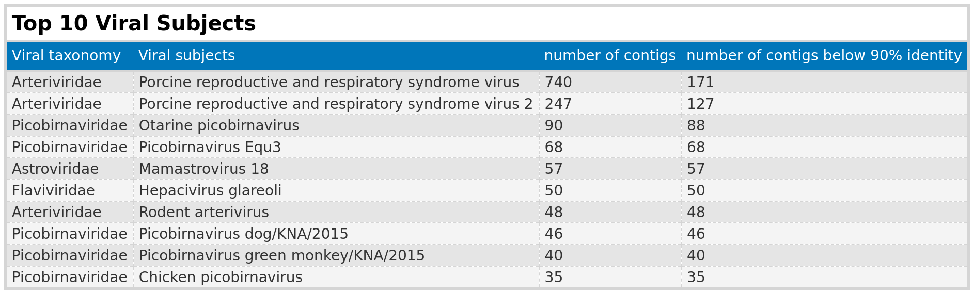
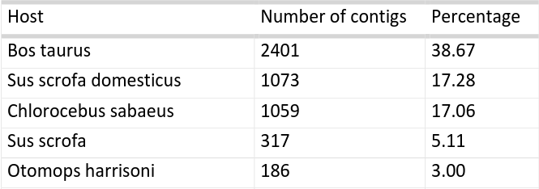
Results: Mammal - Subjects
PRRSV: 981 contigs from study ERP130049, using African green monkey (Chlorocebus sabaeus) cell lines from fetal kidney tissue—not natural infections.
Otarine picobirnavirus: Typically found in sea lions, but detected in domesticated pigs.
Majority of hosts: Farm animals;
! dairy products but listing cattle (Bos taurus) as the host.
Notes:
To see the top 10 potentially novel viruses I seperated them into groups below and above 90 and sorted the top 10 by total.
> I took those 10 groups and filtered for top 10 subjects.
> There are more subjects (1000) but we have to go through them to find something. I just sorted the top 10.

Slide 30
Results:Mammal - Summary
RNA Virus Contig Assembly Results
Assembled 6,209 contigs from 332 samples aligned to RNA virus families.
Cross-finding: Identified 11 non-RNA virus families with lower E-values than RNA viruses.
Contig Characteristics
80.59% (5,004/6,209) of viral contigs exhibited <90% protein sequence identity with the closest known virus.
19.72% (1,225) of contigs were >1,000 nt across all phyla.
444 contigs had a length >1,000 nt and sequence identity <90%.
Dominant Phyla
Top three phyla: Lenarviricota, Kitrinoviricota, and Pisuviricota (most prevalent).
Predominantly associated with farm animal viruses.
Functional Annotation
Consistent identification of RNA-dependent RNA polymerase (RdRp), used for screening.
Many contigs revealed characteristic protein domains specific to their virus families, including an RNA editing site.
Notable Findings
Detected Otarine Picobirnavirus and viruses present in dairy products and fetal kidney cell lines from African green monkeys.
Notes:
Flaviviridae > Appears in most datasets with low identity and large contig lengths
>Arteviridae with the most observations in the dataset, extreme differences in contig length and most subjects found.
> Picobirnaviridae → 99 % of identity below 90 % and contributing 50 % of subjects in top 10.

Slide 31

Import/Export
Results: Virusparies
Processing
Summary Statistics
Reports:
Reproducible
Shareable
Highly modular
Accessible to a broader audience

Slide 32
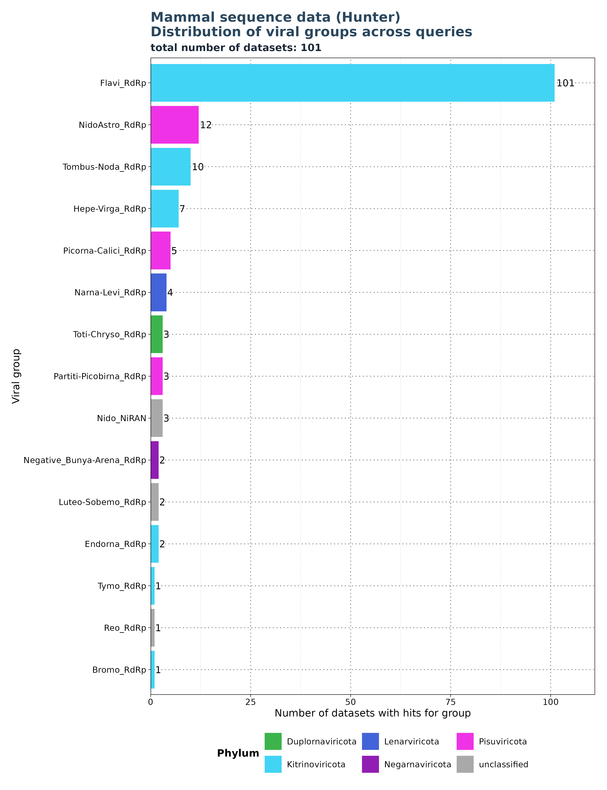
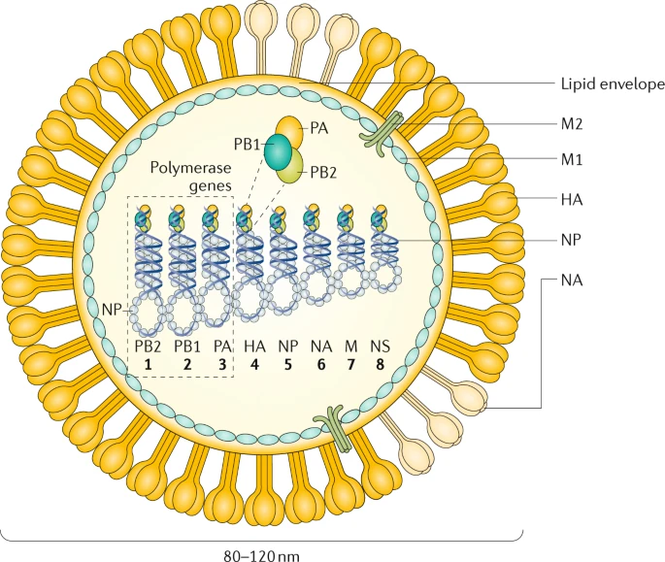
Limitations: Segmented viruses and specificity of profiles
Krammer, F., Smith, G.J.D., Fouchier, R.A.M. et al. Influenza. Nat Rev Dis Primers 4, 3 (2018). https://doi.org/10.1038/s41572-018-0002-y
Search for: Flavi_RdRp.
Notes:
> Profile search is not specific
> Plot: Hunter results for Flavi_RdRp
> Find Flavi in all data sets, but find also others
> Find also Hepe and Bunya → Flavi contributes to other groups and vise virsa → inflates the numbers

Slide 33
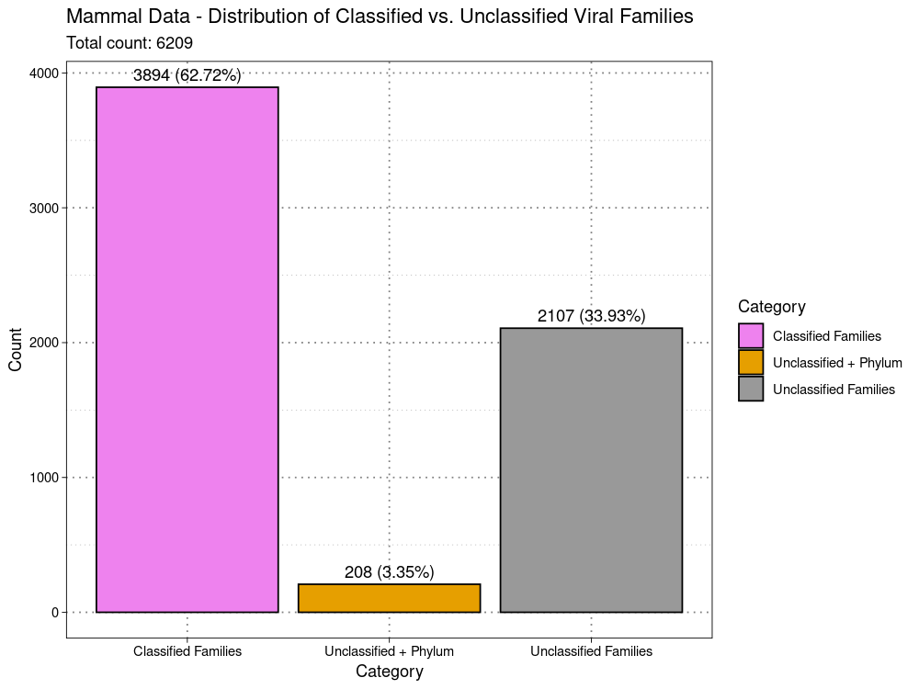
Limitations:
classified vs unclassified
Viral Family extracted from
ViralRefSeq_taxonomy column
ViralRefSeq_taxonomy:
taxid:1354498|Hepacivirus
colobi|Hepacivirus|Flaviviridae|Amarillovirales|Flasuviricetes|Kitrinoviricota|Orthorn
avirae|Riboviria
Notes:
In the last slide you saw that 70 datasets found unclassified.
> That means the viral family was not available in the taxonomy column.
> VirusHunterGatherer just failed to fetch them or fetched other taxonomic information except the family.
> I wanted to know how many observations are unclassified 1/3 of all observations > 1 Dataset can find more than 1 virus > more observatiosn

Slide 34
Concluson and Outlook

Slide 35
Concluson and Outlook
Conclusion
Taubert – liver sequening data:
Analysis complete with only up to 6 files returning assembled contigs.
E-values near cutoff, and short contig lengths.
No conclusive evidence links viral infections to liver rejection.
Mammalian sequening data:
6,209 contigs from 332 samples → 80.59% (5,004) exhibited <90% protein sequence identity → 19.72% (1,225) were >1,000 nt → 444 contigs had a length >1,000 nt and sequence identity <90%.
Cross findings: 11 Non-RNA viruses.
characteristic protein domains specific to their virus families.
known virus families associated with farm animals.
Limitation of utilizing SRA host information: viruses in cultivated cells or host by-products.
Virusparies:
R package designed to enable users to visualize, process, and summarize the hittable outputs from VirusHunterGatherer.
Tool for visualizing or summarizing results → Reports.
Each function is highly modular, allowing users to customize the output of Virusparies functions to their preferences.
Accessible to a larger audience, especially for wet-lab scientists with rudimentary R knowledge.
Virusparies enhances code reusability.

Slide 36
Outlook
Curation:
Eliminate unwanted contigs (non-host entries).
tracing the samples back to the original work to determine the virus's source, the data processing methods used, and any relevant information about the virus or host.
Phylogenetic analysis:
Transition from basic taxonomic annotations to detailed classification.
Verify if novel viruses have new proteins.
Distinguish genuine sequences from contaminants.
Contigs from mammalian sequencing data as future resource:
Contigs could potentially serve as a valuable resource for the Experimental Virology Research Group's current and future projects.
Li Chuin Chong's research on predicting the spillover risk of RNA viruses could benefit from these newly assembled contigs.

Slide 37
Acknowledgement

Slide 38
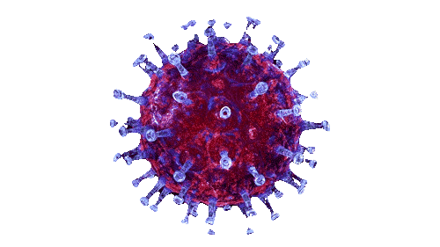
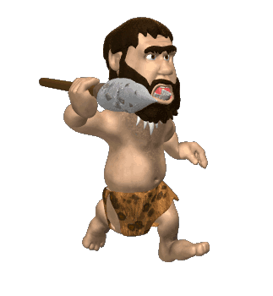
Thank you for listening! Questions?

